Slide 1
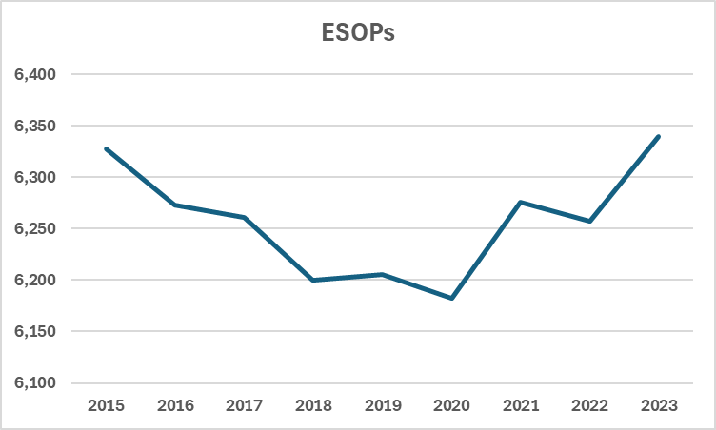
Number of ESOPs (2015-2023)
ESOPs with “active participants” (employees actively accruing benefits)
6,339 plans with active participants in 2023
6,327 plans with active participants in 2015
Source: Rutgers Institute analysis DOL data
conducted by Douglas Kruse, PhD (2026)

Slide 2
Employee ESOP Participants (2004-2023)
More employees are actively accruing benefits in ESOPs today than in the past.
11,038,170
employees
in 2023
Source: Rutgers Institute analysis of 2023 DOL data
conducted by Douglas Kruse, PhD (2026)

