Slide 1
By the Numbers: What do the data show?
Retirement Wealth
$151,332
Typical ESOP account value in private firms.
Pay Ratio in Worker Co-ops
1 : 1.45
Smaller gap between highest- and lowest-paid.
Retention During Downturn
3–4X
ESOPs are far more likely to keep employees on payroll.
Average Worker Wealth
2X
Employee-owners have about double the retirement savings.
Sources: Rutgers Institute; DAWI & USFCW; EOF & Rutgers; NCEO

Slide 2
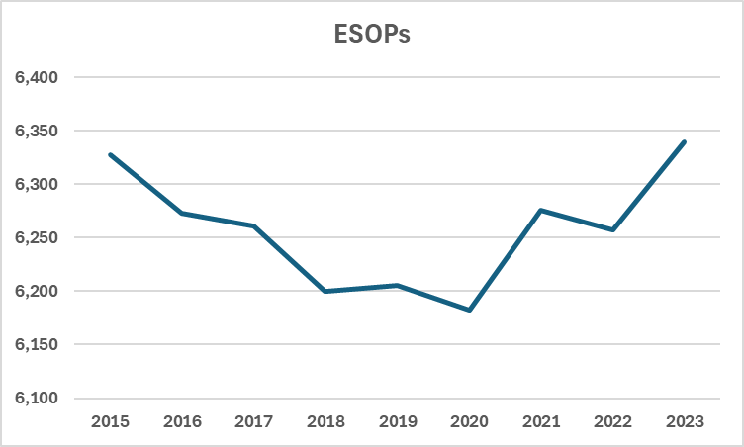
Number of ESOPs (2015-2023)
ESOPs with “active participants” (employees actively accruing benefits)
6,339 plans with active participants in 2023
6,327 plans with active participants in 2015
Source: Rutgers Institute analysis DOL data
conducted by Douglas Kruse, PhD (2026)

Slide 3
Employee ESOP Participants (2004-2023)
More employees are actively accruing benefits in ESOPs today than in the past.
11,038,170
employees
in 2023
Source: Rutgers Institute analysis of 2023 DOL data
conducted by Douglas Kruse, PhD (2026)

Slide 4
Data on United States ESOPs 2023
 | Total number of plans with active participants | Total active participants | Average assets per active participant^ | Average employer securities and property per active participant^
All ESOPs in 2023 | 6,339 | 11,038,170 | $156,884 | $36,137
Publicly held | 399 | 8,427,474 | $150,784 | $21,179
Closely held | 5,940 | 2,610,696 | $176,033 | $83,093
^Average assets per active participant is based on the assumption that average assets are twice as high among active participants as among retired participants, based on prior findings from individual-level ESOP participant data.
Source: Rutgers Institute analysis of 2023 DOL data
conducted by Douglas Kruse, PhD (2026)

Slide 5
Employees in ESOPs by Sector
Source: Rutgers Institute analysis of 2023 DOL data
conducted by Douglas Kruse, PhD (2026)

Slide 6
Two Primary Ways Employees Access Shares
Employee Stock Ownership Plan (ESOP) ~15.2 million covered (employees & retirees) Primary vehicle for large-scale employee ownership in U.S. Broad-based by law. | Equity Compensation Stock grants, stock options, Employee Stock Purchase Plans ~14 million across all equity plans Selective, skewed coverage . Equity access drops sharply by income: 30% upper third | 19% middle third | 6% lower third
Source: Rutgers Institute analysis of 2023 DOL data
conducted by Adria Scharf, PhD (2026)

